Slide 1
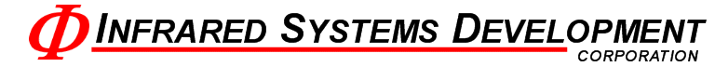
High Precision Temperature Controller
Group 13
Ashley Desiongco
Stacy Glass
Martin Trang
Cara Waterbury

Slide 2
Objectives
Replace COTS controller
More Efficient
More Economical
Use modern technology
Part selection must consider production life
Notes:
10 year prod cycle

Slide 3
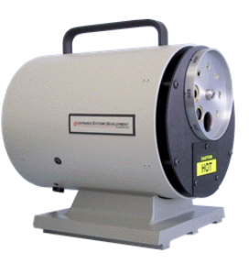
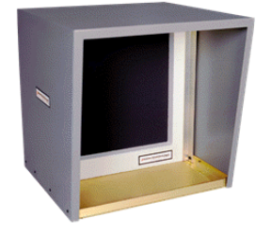
Application
Extended Area
Cavity
Will use 2 Type T T/C or 4 RTDs
From -30°C to 700°C
Will use 2 Type S T/C
From 50°C to 1200°C
Notes:
Currently uses single RTD, one Type S

Slide 4
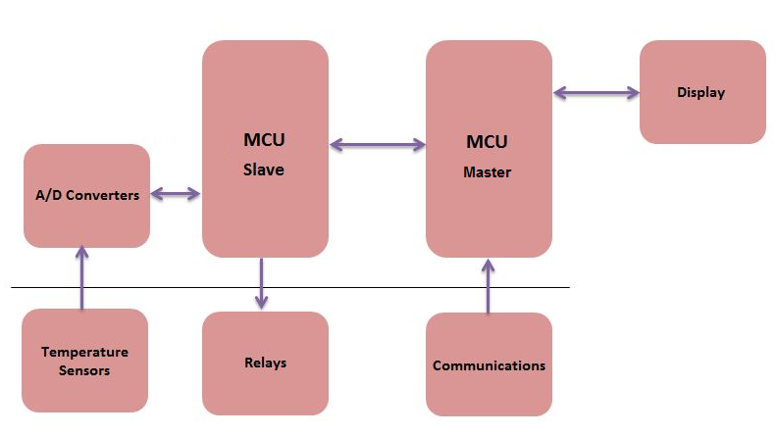
Top Level Block Diagram

Slide 5
Analog Subsystem

Slide 6
Sensor & Reading Specifications
Must stabilize within +/- .5°C
Read a minimum of:
2 differential thermocouple signals
5 RTD signals
Convert to digital signal and send to PIC
All noise/drift must be accounted for

Slide 7
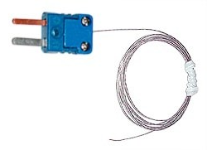
Sensor Types
Thermocouples
RTDs
Type S
20 ⁰C min
1300 ⁰C max
0.1107 mV to 13.17 mV
Cavity source
Type T
-30 ⁰C min
400 ⁰C max
-1.21 mV to 20.87 mV
Extended area source
PT100
-30 ⁰C min
400 ⁰C max
Extended area source:
88.22 Ω to 247.09 Ω
Cold junction comp:
100 Ω to 123.24 Ω

Slide 8
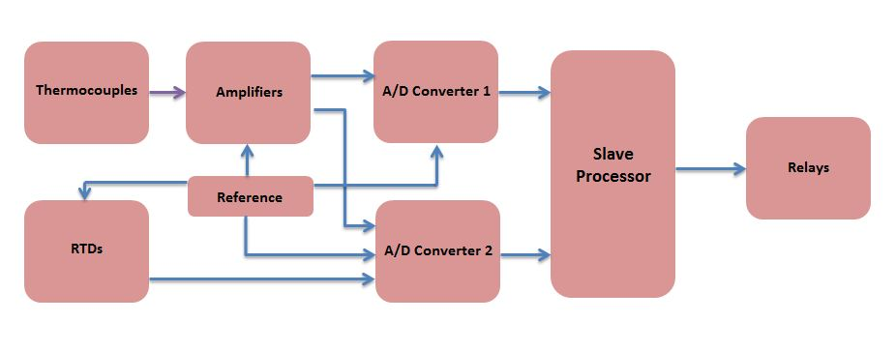
Block Diagram

Slide 9
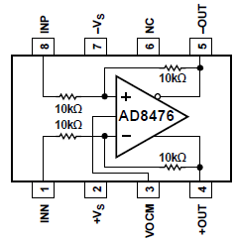
Differential Op Amp
Differential output conditioning Op Amp
V_{OCM} = 2.5 V reference voltage
Internal precision 10kΩ resistors

Slide 10
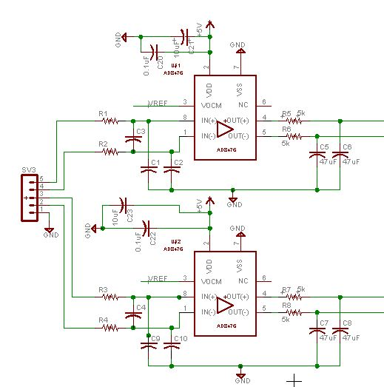

Slide 11
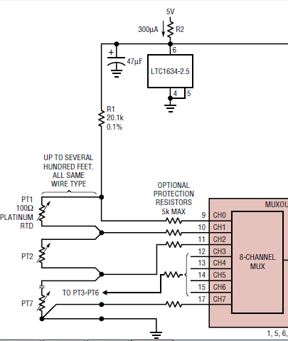
RTD Readings
RTD ladder
Requires only 1 precision resistor
Must match min input requirements of AD converter

Slide 12
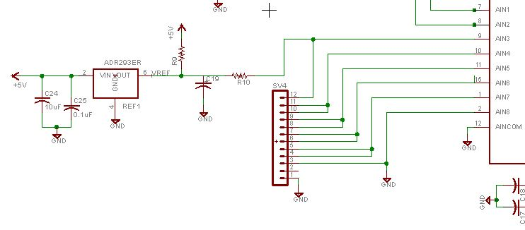
Schematic

Slide 13
A-D Converters
AD7797
AD7718
24 bit resolution
1 differential input
SPI interface
Internal gain amplifier fixed at 128
Used for heater (TC) reading
24 bit resolution
8 channel input MUX
SPI interface
Internal PGA of 1 to 128
Used for all RTD readings and secondary TC reading

Slide 14

Reference Voltage Considerations
Component | Current Draw
AD7797 | 1 μA
AD7718 | 1.25 μA
AD8476 – Op Amp (2) | 5 μA
RTD Ladder | 713 μA
TOTAL | 720.25 μA
V_{out} = 2.5 V
I_{out} = 40 mA
Temp drift = 3ppm/ ⁰C

Slide 15
Microcontroller
Notes:
Once the information is on the ADC, it’s the MCU job to process that information

Slide 16
Microcontroller Specifications
Capable of Communicating with 8 Peripheral Devices.
Capable of Handling RS-232, RS-485, USB, and Ethernet Protocols.
Capable of performing signed, floating point math.
Notes:
These are the main three specs we have for it. First

Slide 17
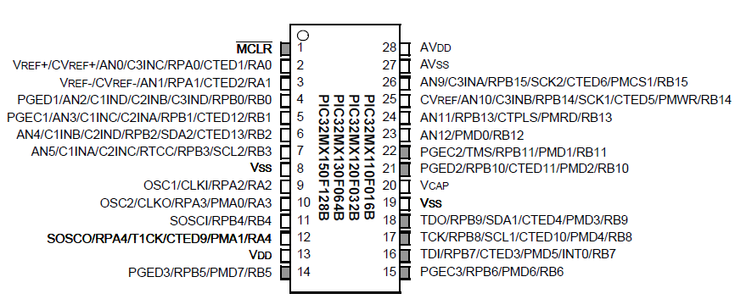
PIC32MX150F128B
2 SPI Interfaces
2 UART Interfaces
Full-featured ANSI-Compliant C Programming Language
Notes:
And the MCU that fit the bill was the pIC32mx150F128B

Slide 18
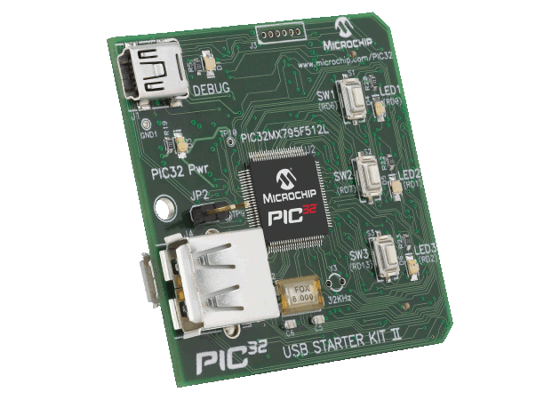
General Design
Two PIC32MX150F128B connected in Master-Slave configuration.
Slaves will be customized to serve a single purpose.
Master will handle outside communication and slave coordination.
Notes:
Our general configuration for the microcontroller is to have two pIC32MX150128B connected in Master-Slave Configuration

Slide 19
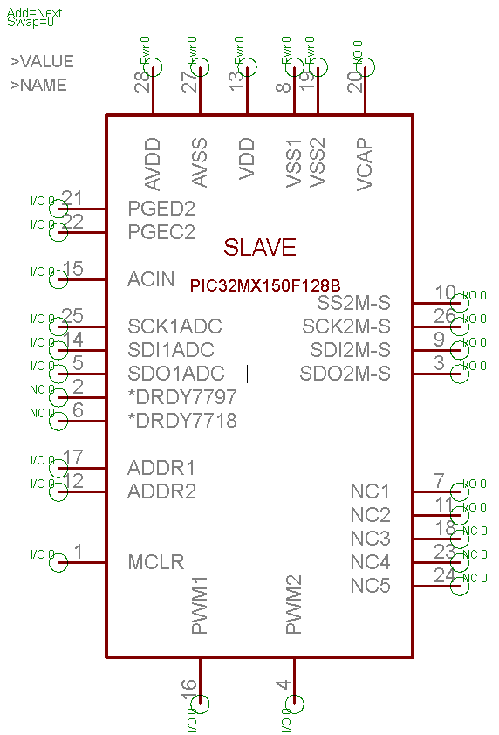
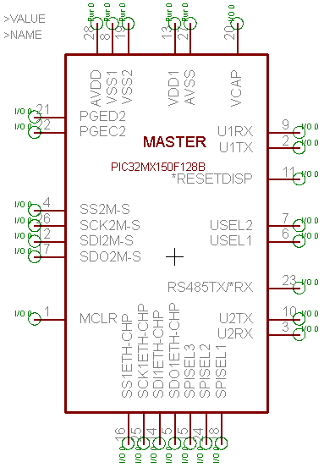
Pinout

Slide 20
Peripherals (from the Master)
MAX232 – RS232 – UART
MAX481 – RS485 – UART
MCP2200 – USB – UART
ENC28J60 – Ethernet – SPI
µLCD-32032 – Display – UART
PIC32MX150F128B – Slave – SPI
Independent 8-level deep FIFO TX/RX UART Buffers
Independent 4-level deep FIFO TX/RX SPI Buffers onboard the PIC32MX150F128B

Slide 21

Development Environment
MPLABX using MPLAB C32
Simulation Capability
Debugging
Using PICKIT3

Slide 22
Display

Slide 23
Requirements
Touch Screen
Low-Cost
Fit in existing chassis
Interface easily to microcontroller

Slide 24
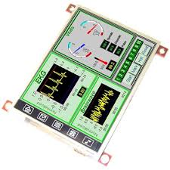
4D-Systems uLCD32 (GFX)
Built in Graphics
Controller
Easy 5-pin interface
On-board Audio
Micro-SD card connector
Expansion Ports
Built in Graphics Libraries

Slide 25
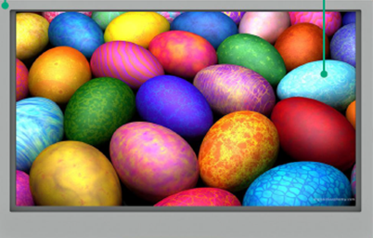
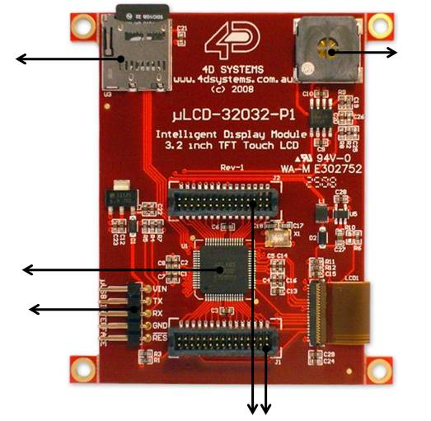
Features
1
480x272 Resolution
Expansion Ports (2)
5 Pin Serial Programming Interface
PICASO-GFX2 Processor
Micro-SD Card Slot
1.2W Audio Amplifier with Speaker
3.2”
5
6
4
3
2

Slide 26
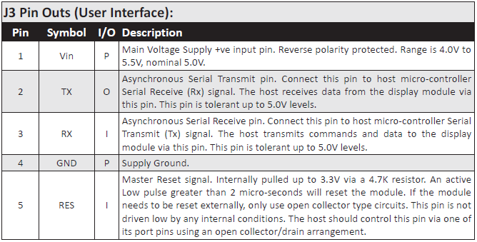
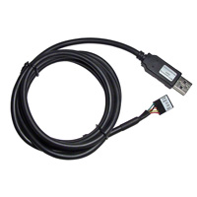
Hardware Interface
Easy 5 pin interface
Vin, TX, RX, GND, RESET
Also used to program display with 4D Programming Cable

Slide 27
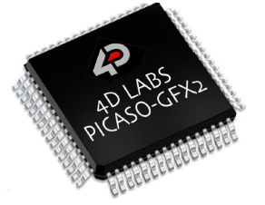
PICASO-GFX2 Processor
Custom Graphics Controller
Configuration available as a PmmC (Personality-module-micro-Code)
PmmC file contains all low level micro-code information

Slide 28
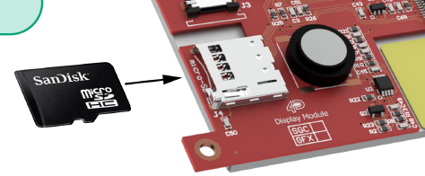
Audio/Micro-SD Card
Audio support is supplied by the PICASO-GFX2 processor, an onboard audio amplifier and 8-ohm speaker
Executed by a simple instruction
Micro-SD card is used for all mulitmedia file retrieval
Can also be used as general purpose storage

Slide 29
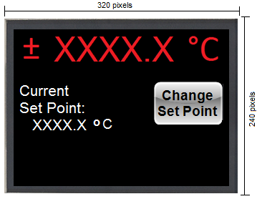
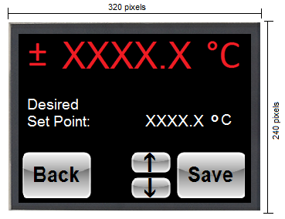
Temperature displayed at all times
Change current set point option

Slide 30
Power

Slide 31
Power
Part | Current (mA) | Voltage (V) | Quantity | Power (mW)
ADC | 0.65 | 5 | 1 | 3.25
ADC | 0.325 | 5 | 1 | 1.625
ADC | 0.65 | 3.3 | 1 | 2.145
ADC | 0.325 | 3.3 | 1 | 1.0725
OpAmp | 0.33 | 5 | 2 | 3.3
Ref | 0.8 | 5 | 1 | 4
Quad Buffer | 30 | 5 | 1 | 150
RS485 | 0.9 | 5 | 1 | 4.5
RS232 | 15 | 5 | 1 | 75
USB | 95 | 5 | 1 | 475
Ethernet Controller | 180 | 3.3 | 1 | 594
Display | 150 | 5 | 1 | 750
Microcontroller | 50 | 3.3 | 2 | 330
4:1 MUX | 75 | 3.3 | 1 | 247.5
TOTALS | 649.31 |  |  | 2641.393

Slide 32
Power Block Diagram
ADC RS485
OpAmp RS232
Ref. Display
Buffer USB
LS25-5
90 – 240 Vac
5V
LT1129-3.3
Ethernet
Microcontroller
4:1 MUX
ADC
3.3V

Slide 33
Temperature control Method

Slide 34
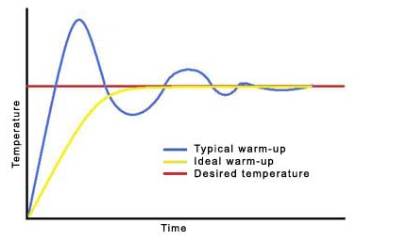
PID Requirements
Eliminate noise
Minimize overshoot
More efficient than standard PID

Slide 35
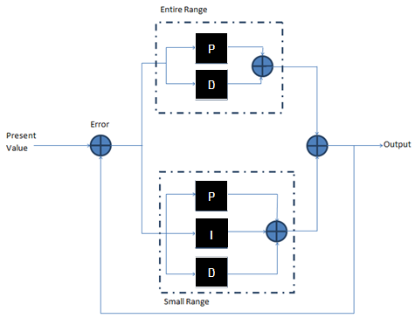
Nested PID
Influence of parameters:
P = Decreases rise time
I = Eliminates SS Error
D = Decreases overshoot and settling time
Initial loop encompasses entire temperature range using only P and D parameters
Next loop focuses on a smaller range and uses P, I and D

Slide 36
Analog system software design

Slide 37
Interfacing with AD7797
Thermocouple Reading
Initialize AD7797 to the following settings:
Unipolar Mode: 0 – 20 mV
Sampling Frequency: 123 Hz
Clock Source: Internal 64 kHz
Converting Mode: Continuous Conversion Mode
Reading data output register:
Send 0x58FFFFFF to DIN of AD7797 – Single Read Operation

Slide 38
Interfacing with AD7718
CJC Reading
Initialize AD7718 to the following settings:
Unipolar Mode
Programmable Gain: 128
Sampling Frequency: 105.3 Hz
Chopper Enabled
Converting Mode: Continuous Conversion Mode
Channel Select: AIN(+) – AIN3; AIN(-) – AIN4
Reading data output register:
Send 0x44FFFFFF to DIN of AD7718 – Single Read Operation

Slide 39
Temperature Conversion
Acquire CJC equivalent voltage reading
Acquire thermocouple voltage
Subtract CJC voltage from thermocouple voltage
Translate to temperature using NIST Standard Tables.
AD7718 Formula
AD7797 Formula

Slide 40
Peripheral software design

Slide 41
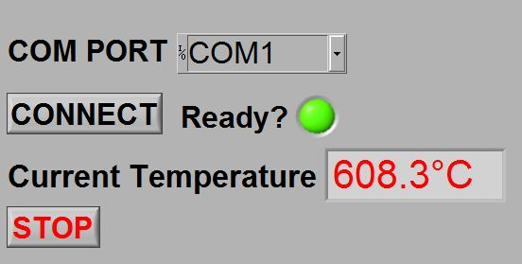
General Overview
No Interrupt Driven Events
Constant Polling Transmit/Receive Buffers for SPI and UART
Master PIC handles data transfer to and from the Display and Slave PIC
Master PIC serves as a slave to the Computer Interface.
Custom LABVIEW software to handle all computer interfacing.

Slide 42
Display software Design

Slide 43
General Overview
Polls RX buffer for command from master
0x01: master to send current temperature
0x02: master to send new set point
0x03: master requests new set point from display
Handles touch events
Uses internal functions to determine location of touch events

Slide 44
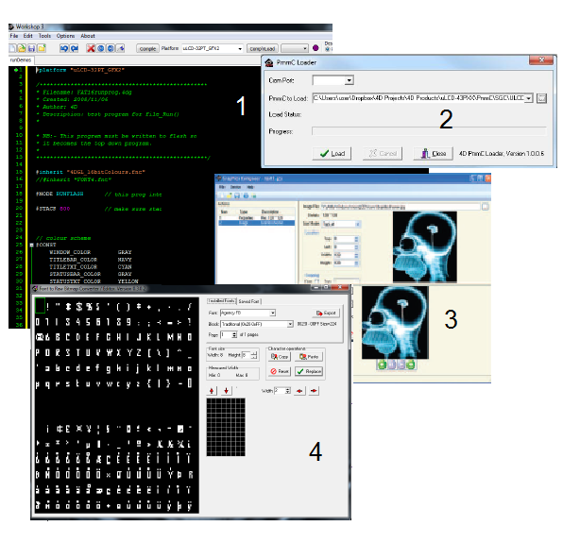
Software Tools
1. 4D Workshop IDE
2. PmmC Loader
3. Graphics Composer
4. FONT Tool

Slide 45
Temperature Formatting
Data sent in 3 bytes from master or display
Display UART is limited to 1 byte
First Byte: Contains tenths place (upper four bits) and ones place (lower four bits)
Second Byte: Contains tens place (upper four bits) and hundreds place (lower four bits)
Third Byte: Contains Thousands place (upper four bits) and sign/check bit (lower four bits)
Fourth bit must be set high for data to be valid.

Slide 46
PID software Design

Slide 47
General Overview
Compare Set Point temperature with Current temperature
Check if the current temperature is within the proportional band
Accumulate error (for Integral Action) and store previous temperature (for Derivative Action)
Calculate Proportional, Integral, and Derivative terms
Translate PID terms into varying duty cycles for PWM output

Slide 48
Testing

Slide 49
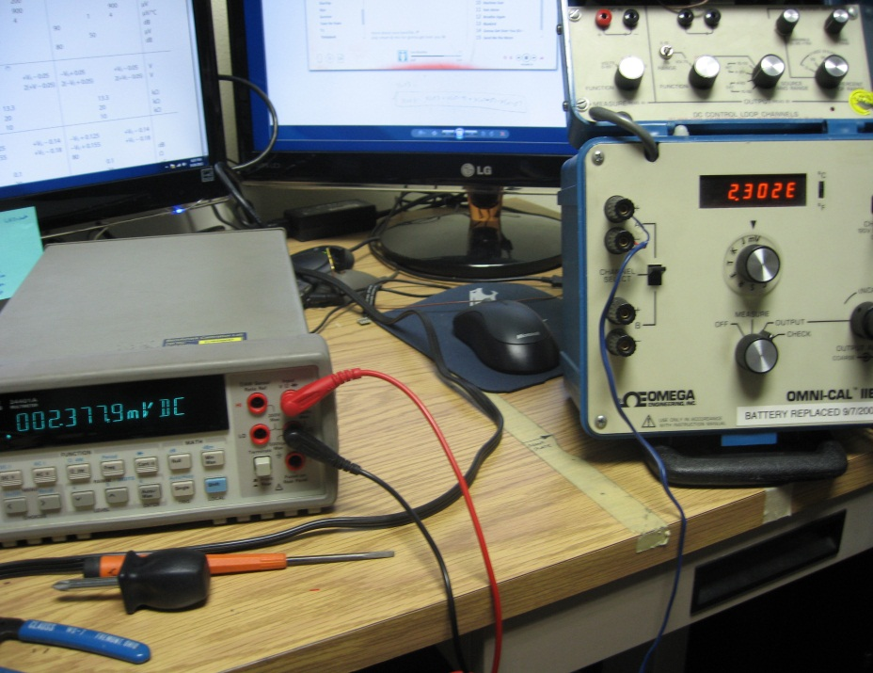
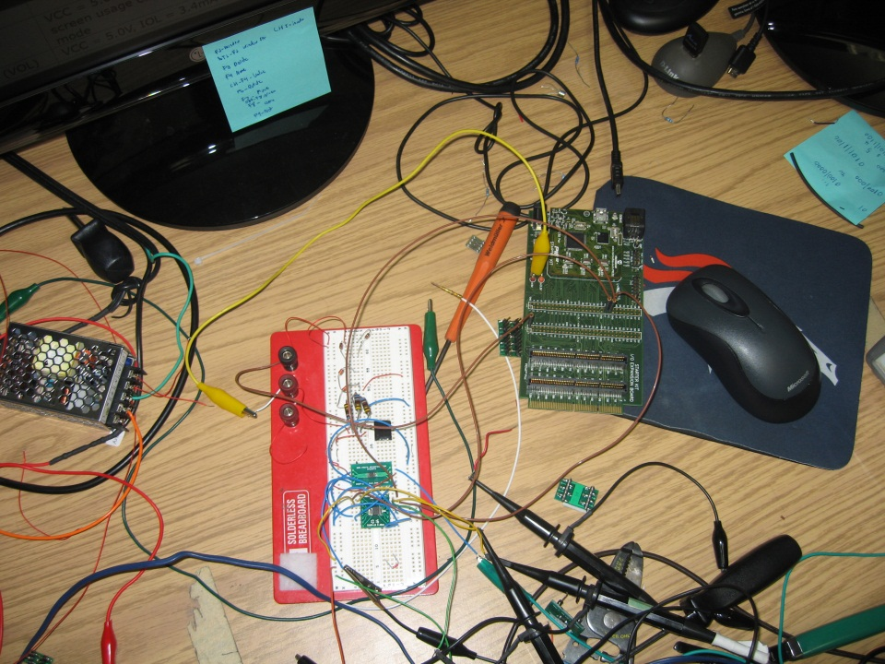
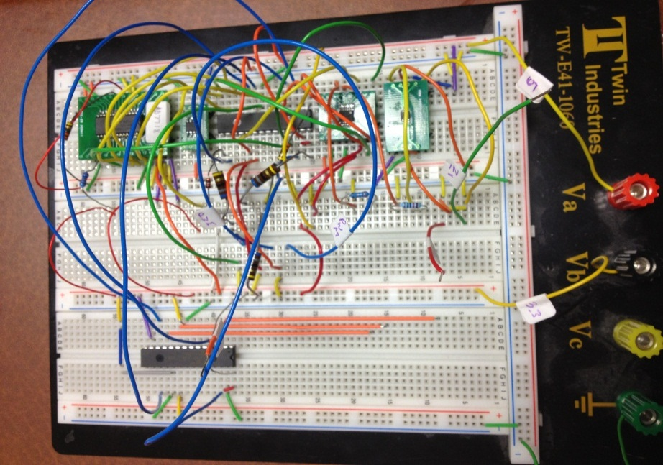
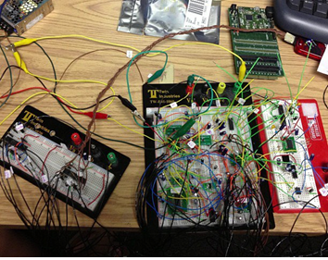
Testing OpAmp
Testing AD7797 (via PIC32 Starter Kit)
Testing AD7797 (via PIC32MX150F128B)
Full System Integration Testing

Slide 50
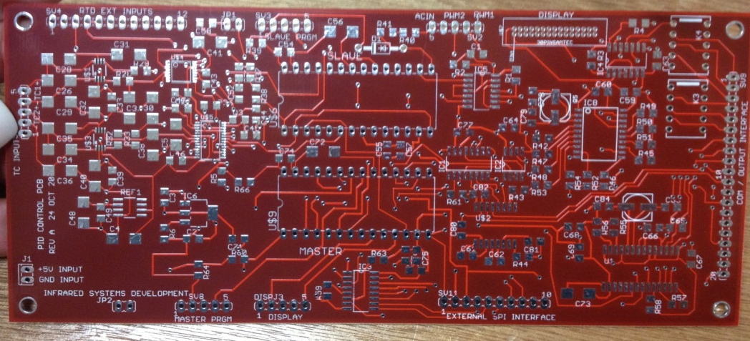
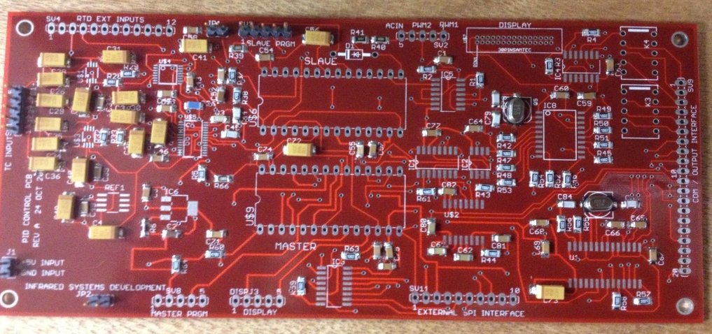
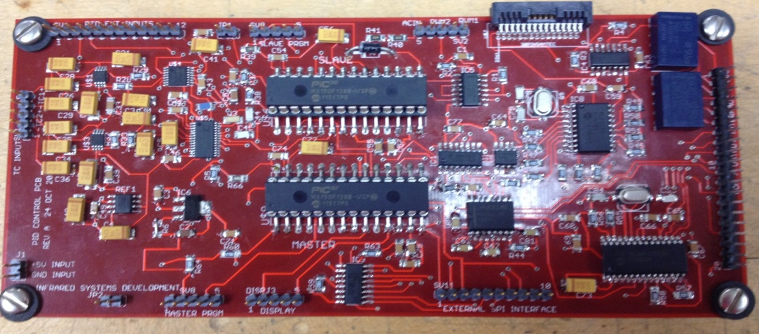
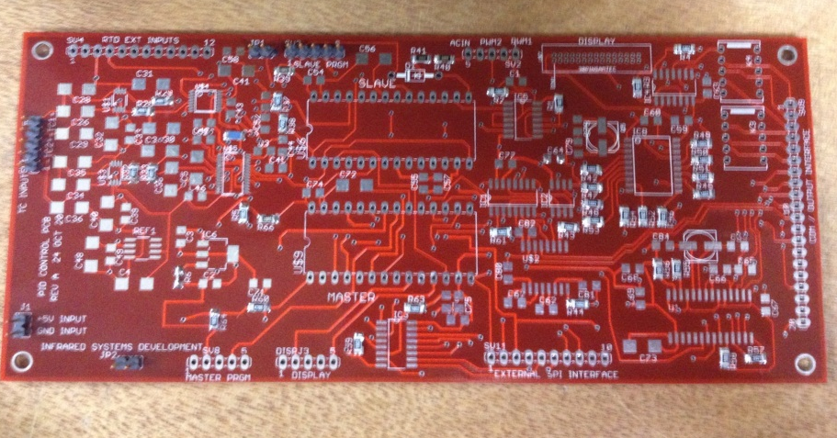
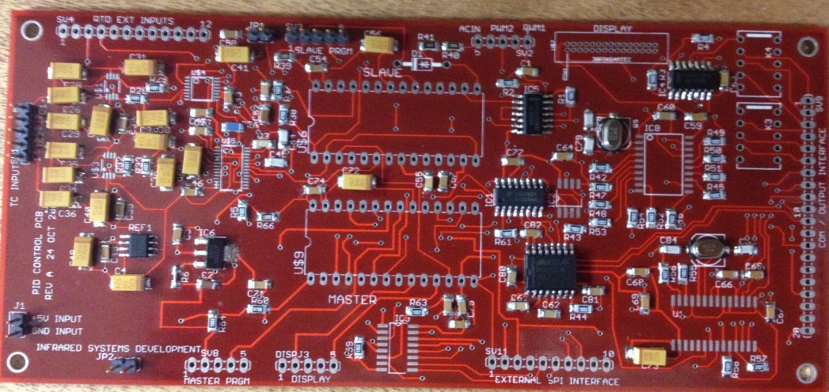

Slide 51
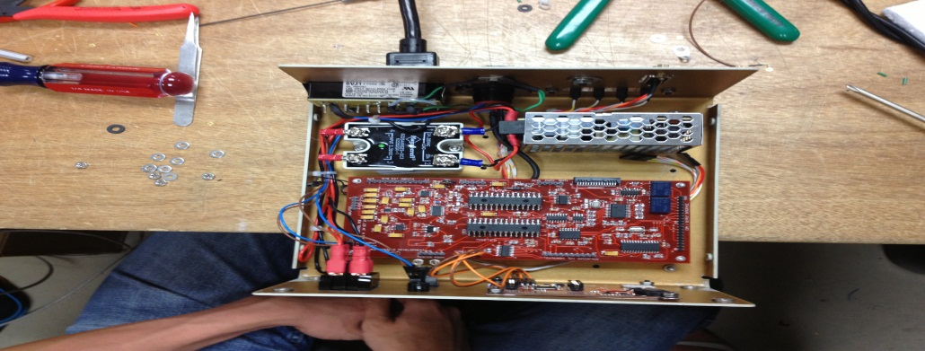
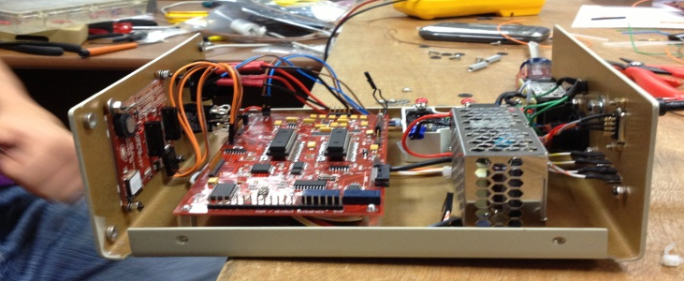
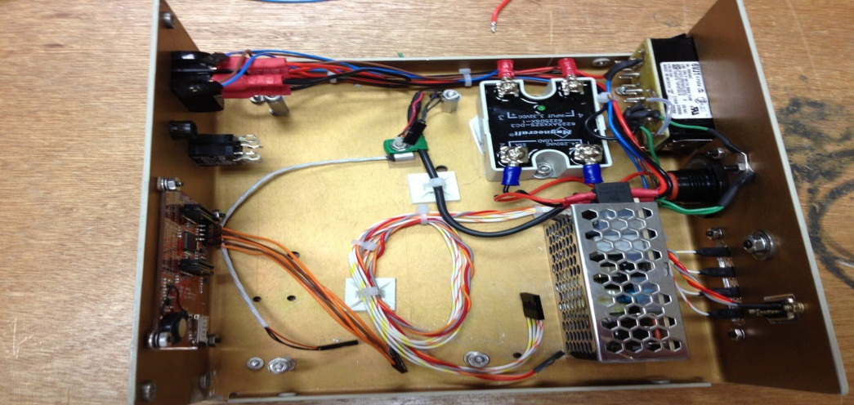
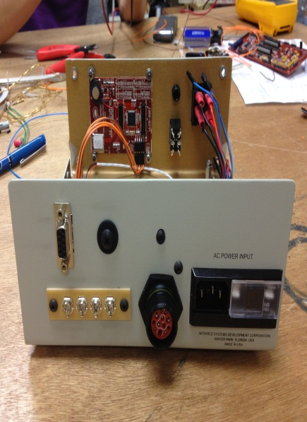
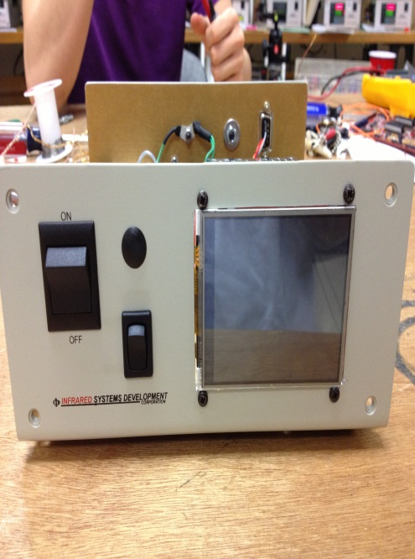
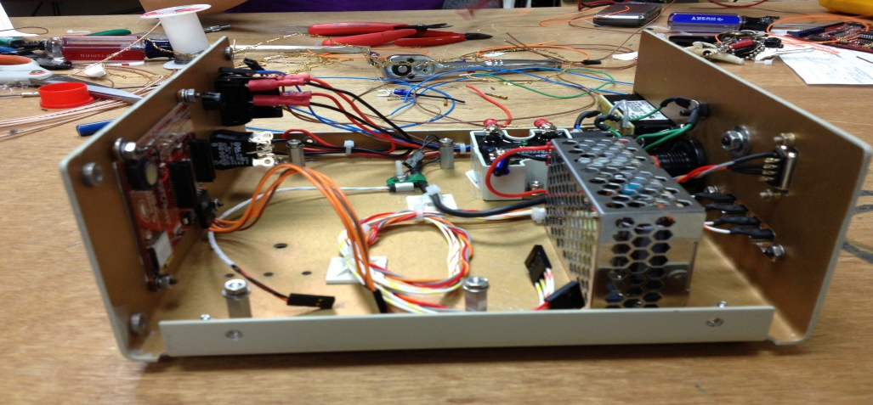

Slide 52
Pid parameter Testing

Slide 53
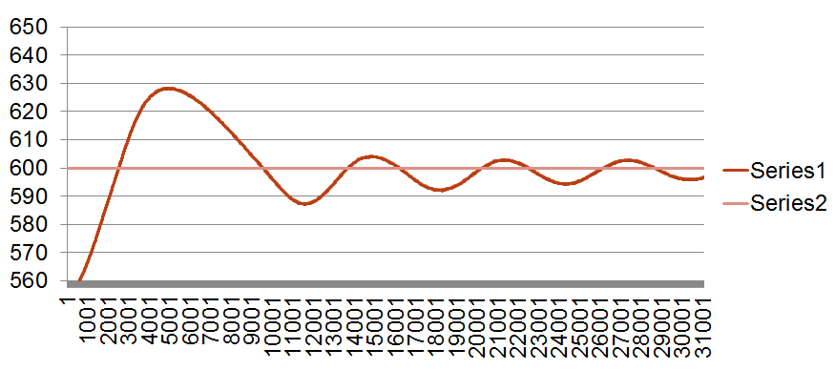
Trial 1
P Band = 5%
Repeats per Minute= .65
Derivative Time= .001
Set Point = 600.0°C

Slide 54
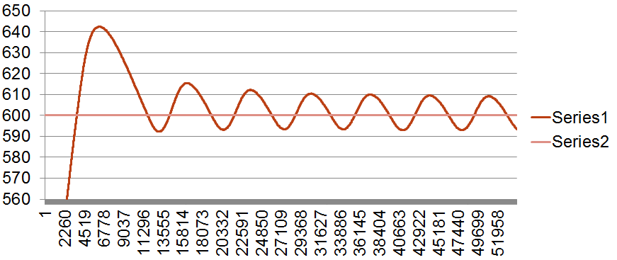
Trial 2
P Band = 5%
Repeats per Minute= .50
Derivative Time= .01
Set Point = 600.0°C

Slide 55
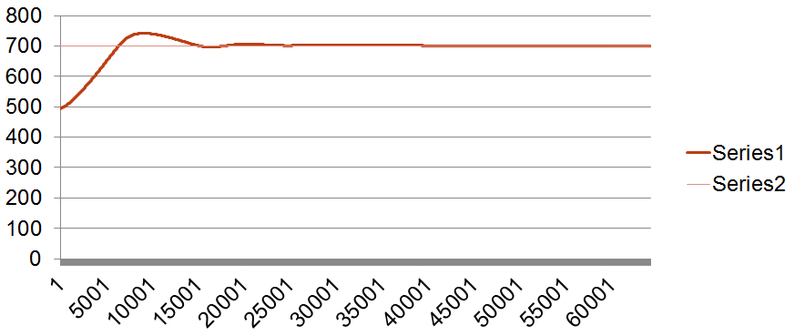
Trial 3
P Band = 5%
Repeats per Minute= .50
Derivative Time= .01
Set Point = 700.0°C

Slide 56
Work Breakdown
 | Ashley | Martin | Cara | Stacy
Analog Hardware | 95% | 5% | - | -
Digital Hardware | - | 80% | - | 20%
Display | - | 5% | 95% | -
Software | 5% | 10% | 5% | 80%
Power | - | - | 100% | -

Slide 57
Budget
Parts
Digital Devices | $ 21
Analog Devices | $ 30
Passive Devices | $ 62
Power Devices | $ 20
Display | $ 101
Board Fabrication | $ 80
Programming Tools | $ 52
TOTAL | $ 366
Goal: $500

Slide 58
Educational Experience
Conflicting Reprogrammable pin assignment definitions
LATx versus PORTx
Three Tier SPI handshaking
Board Population

Slide 59
QUESTIONS?

